Slide 1
PREDICTION MODEL OVERVIEW
Arielle Thibeault

Slide 2
AGENDA
Introduction
EDA
Dimension Reduction
Models Considered
Final Model

Slide 3
INTRODUCTION
Provided data from the College, Edwards, and Old Town neighborhoods
Develop a prediction model for a property’s Sale Price within these three neighborhoods to be used for future estimates

Slide 4
EDA
Exploratory Data Analysis

Slide 5
Data Cleaning
Purpose: transform the data into a format usable for analysis
Removed | Added | Expanded | Mapped
‘Kitchen Above Grade’ and ‘Unfinished Basement Square Footage’ Incomplete, duplicated, and impossible records | A record ID with a unique identifier for each record | Lot Information: Lot Configuration, Lot Shape, Lot Area, and Lot Frontage Exterior: Exterior 1st, Exterior Quality, and Exterior Condition | Qualitative observations with simple values were recoded

Slide 6
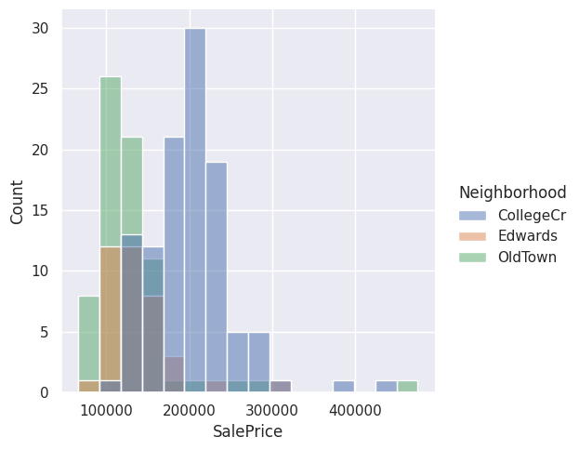
16 numeric, 24 qualitative variables
109 records from College Cr, 38 from Edwards, and 71 from Old Town
Most of the houses considered are one-story homes, 111 in total
Homes in the College Cr Neighborhood have a higher Sale Price on average

Slide 7
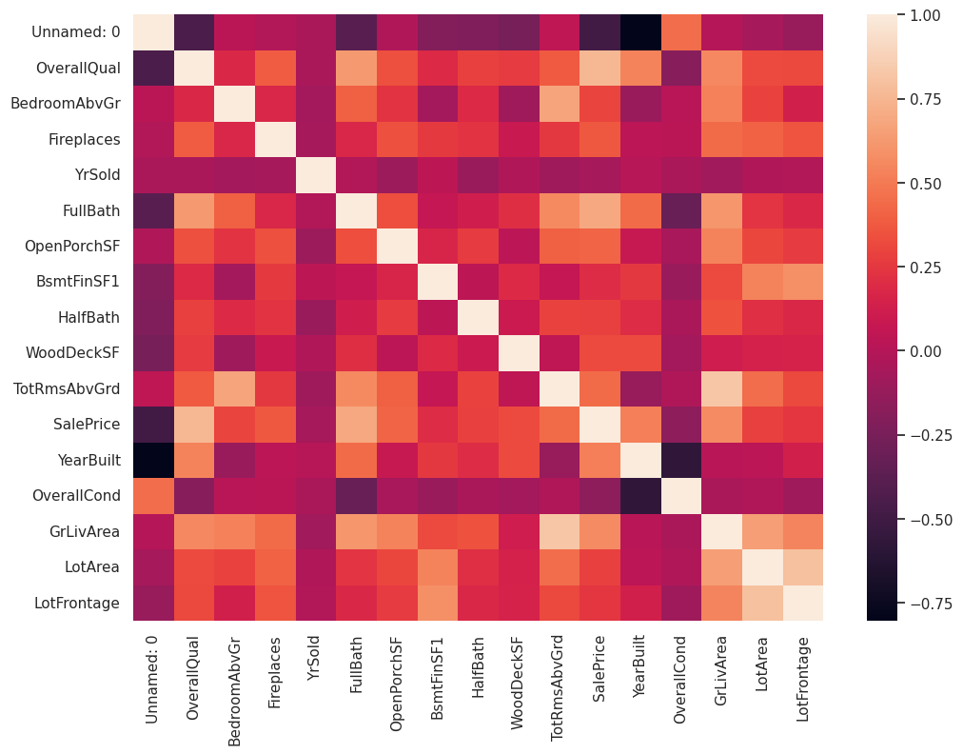
Exploratory data analysis

Slide 8
Dimension reduction

Slide 9
PCA, MCA, ANOVA
Principal Component Analysis
Multiple Correspondence Analysis
Analysis of Variance
Recombines our numerical measurements into a smaller set that are the most useful to describe our desired quantity
Identifies underlying patterns in our categorical measurements to detect redundancies
Determines whether the influence of particular inputs significantly effect the outcome

Slide 10
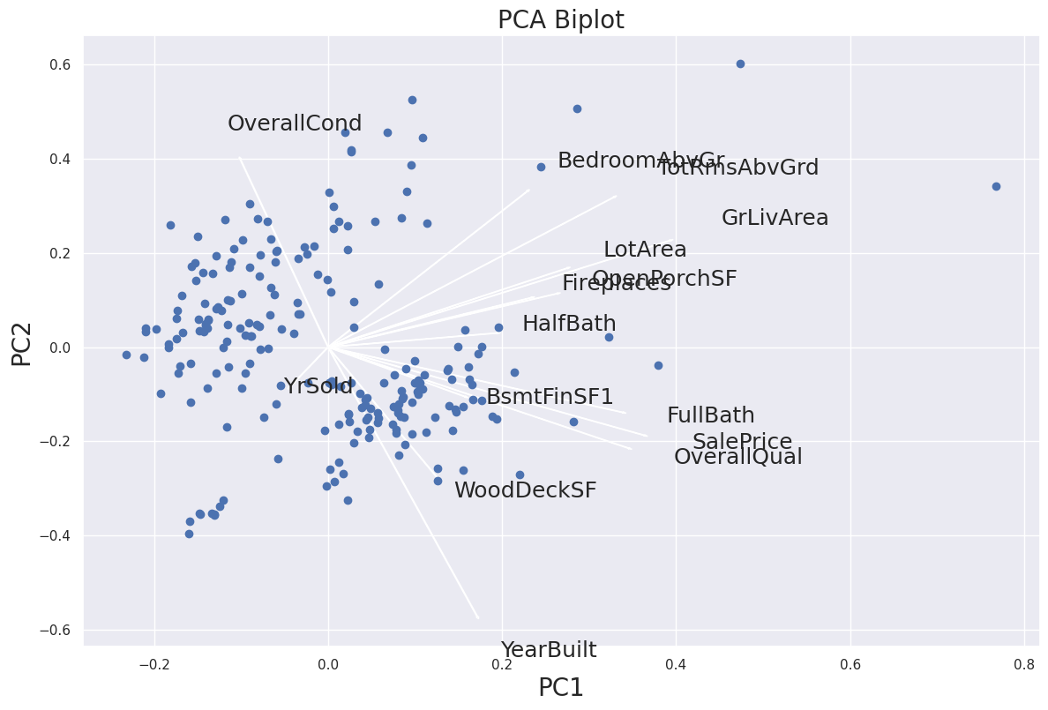
Results
Not enough overlap to confidently reduce predictors without sacrificing the prediction power

Slide 11
Models considered
MULTIPLE REGRESSION
Machine Learning model
Calculates quantifiable relationships between the inputs and the outcome
RANDOM FOREST/ DECISION TREE
Machine Learning model
Maps possible outcomes from a series of related choices
HISTOGRAM BOOSTING GRADIENT TREE
Modification of the Decision Tree
Models are assembled sequentially versus simultaneously
Machine Learning model
Constructs classification regions for possible outcomes based on probability
SUPPORT VECTOR REGRESSION

Slide 12
Results
We ultimately settled on our Histogram Boosting Gradient Tree Model
This method was the most resistant to variations in the data
​The model calculated the lowest error rate compared to the other models
Requires no assumptions about the structure of the inputs

Slide 13
SUMMARY
After scrubbing the three data sets, we evaluated four machine learning model types to predict the Sale Price for houses in the three neighborhoods.
We concluded the Histogram Boosting Gradient Tree Model was the most appropriate for making predictions going forward.

Slide 14
THANK YOU
Arielle Thibeault
abt5692@psu.edu

